Slide 1

Python for Data Science
File Handling · OOP · Exceptions · Iterators · Generators · Decorators

Slide 2
What We'll Cover Today
A complete beginner's roadmap — from reading files to building powerful Python programs.
File Handling
Object-Oriented Programming
Open, read, write, and manage files — including CSV and JSON
Classes, objects, inheritance, encapsulation, and more
Exception Handling
Iterators, Generators & Decorators
Catch errors gracefully — prevent program crashes
Advanced but beginner-friendly Python power tools

Slide 3


What Is a File & Why Does It Matter?
A file is a collection of data stored permanently on a storage device such as a hard disk, SSD, or USB drive.
Files allow programs to:
Store data permanently
Read saved data later
Share information between applications
Think of a file like a notebook 📓
A file is a named container on your computer that stores data permanently — even after you turn the power off.
In Data Science, almost all datasets arrive as files. Mastering file handling = mastering data loading.
Text Files (.txt)
CSV Files (.csv)
JSON Files (.json)
Plain readable text — logs, notes
Spreadsheet rows — used in pandas
API data — structured key-value pairs

Slide 4
Why File Handling is Important?
File Handling means creating, reading, writing, updating, and deleting files using programming languages like Python.
Without file handling:
Data would disappear after the program stops running.
Applications could not save user information.
Machine learning models could not use datasets.
File Handling Helps To:
Save data permanently
Read existing data
Update stored information
Process large datasets
Automate reports and logs

Slide 5

The open() Function & File Modes
Use open(filename, mode) to tell Python which file to open and what to do with it.
Mode
Meaning
Real-Life Analogy
Creates File?
r
Read only
Opening a book to read 📖
No
w
Write (overwrite)
Erasing the whiteboard and rewriting ✏️
Yes
a
Append
Adding a new line to your diary ➕
Yes
x
Create new file
Buying a brand-new notebook 🆕
Yes (fails if exists)
rb / wb
Read/Write binary
Copying image or audio files 🖼️
Depends
f = open("data.txt", "r") # Opens data.txt in read mode
content = f.read() # Reads entire file content
f.close() # Always close the file!
⚠️ Beginner Mistake: Forgetting to call f.close() can corrupt files or cause memory leaks.

Slide 6

Read, Write, Append & the with Statement
with Statement (Context Manager)
What is a Context Manager?
A Context Manager is a feature in Python that automatically manages resources like:
Files
Database connections
Network connections
It ensures resources are properly opened and automatically closed after use.
In file handling, the with statement acts as a context manager.
Reading a File
with open("notes.txt", "r") as f:
print(f.read()) # Full content
# f.readline() # One line at a time
# f.readlines() # List of all lines
Writing & Appending
Why with is best
with open("notes.txt", "w") as f:
f.write("Hello, World!") # Overwrites!
with open("notes.txt", "a") as f:
f.write("\nNew line added") # Appends
Auto-closes the file
No need to remember f.close()
Safer code
File closes even if an exception is raised
The with statement automatically closes the file — even if an error occurs. Always prefer it over manual close().
Cleaner & Pythonic
Preferred in all professional projects

Slide 7
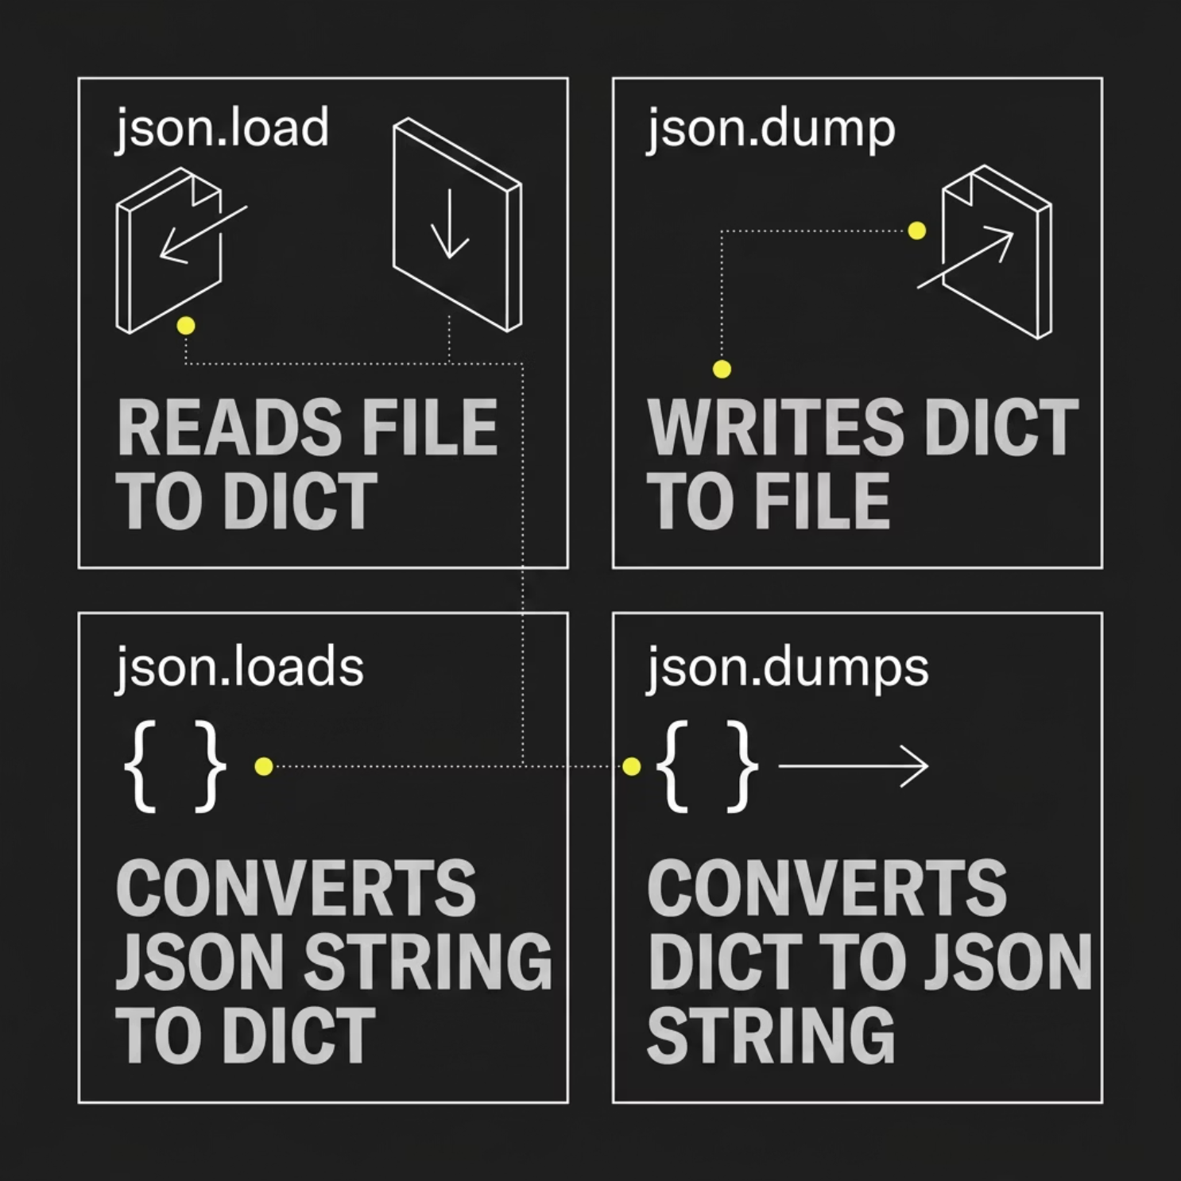


Working with JSON Files
JSON = JavaScript Object Notation
JSON is the universal language of APIs. It looks just like a Python dictionary — making it easy to work with in Data Science.
# Reading JSON from a file
import json
with open("data.json", "r") as f:
data = json.load(f) # dict from file
print(data["name"])
# Writing Python dict → JSON file
student = {"name": "Alice", "age": 21}
with open("out.json", "w") as f:
json.dump(student, f)
# String conversions
s = json.dumps(student) # dict → string
d = json.loads(s) # string → dict
📡 In Data Science, API responses (weather, Twitter, stock data) all come as JSON strings. json.loads() parses them instantly.

Slide 8

Object-Oriented Programming (OOP): The Foundation
It is a programming approach where programs are designed using:
Objects
Classes
instead of only functions and logic.
Why OOP is Useful
OOP helps programmers:
Organize code better
Reuse code
Build large applications easily
Reduce code duplication
Improve maintainability
Classes are Blueprints, Objects are Instances
At its core, OOP lets you define Classes — abstract templates for things like a Car or a User. From these blueprints, you create Objects — actual, tangible instances, each with unique properties and abilities.
Think of a Car class as the design for all cars. Each car on the road is an object of that class, like your red Honda Civic or a friend's blue Ford F-150.

Slide 9
What is a Class?
A Class is a blueprint or template used to create objects.
A class defines:
Attributes (data/properties)
Methods (functions/actions)
class Keyword
In Python, classes are created using the class keyword.
What is an Object?
An object is an instance of a class.
Objects are real entities created from the class blueprint.
Why Classes and Objects Are Useful?
They help:
Organize programs
Reuse code
Model real-world entities
Reduce repetition

Slide 10
Classes, Objects & the __init__ Constructor
Bring your blueprints to life! Learn how to define classes, create objects, and initialize their state.
Defining Your First Class
class Car:
# The __init__ constructor
def __init__(self, make, model, color):
self.make = make
self.model = model
self.color = color
self.speed = 0
# A method (behavior)
def accelerate(self, increment):
self.speed += increment
# Creating objects (instances)
my_car = Car("Honda", "Civic", "Red")
friends_car = Car("Ford", "F-150", "Blue")
# Accessing attributes
print(f"{my_car.color} {my_car.make} {my_car.model}")
# Calling methods
my_car.accelerate(50)
print(f"My car's speed: {my_car.speed} mph")
__init__: The Object's First Breath
1
Initializes Objects
Called automatically when a new object is created. Think of it as the setup function.
2
Sets Attributes
Used to assign initial values to an object's properties (like make, model, color).
3
The self Keyword
Always the first parameter; refers to the instance of the class being created. Essential for defining instance-specific attributes and methods.

Slide 11
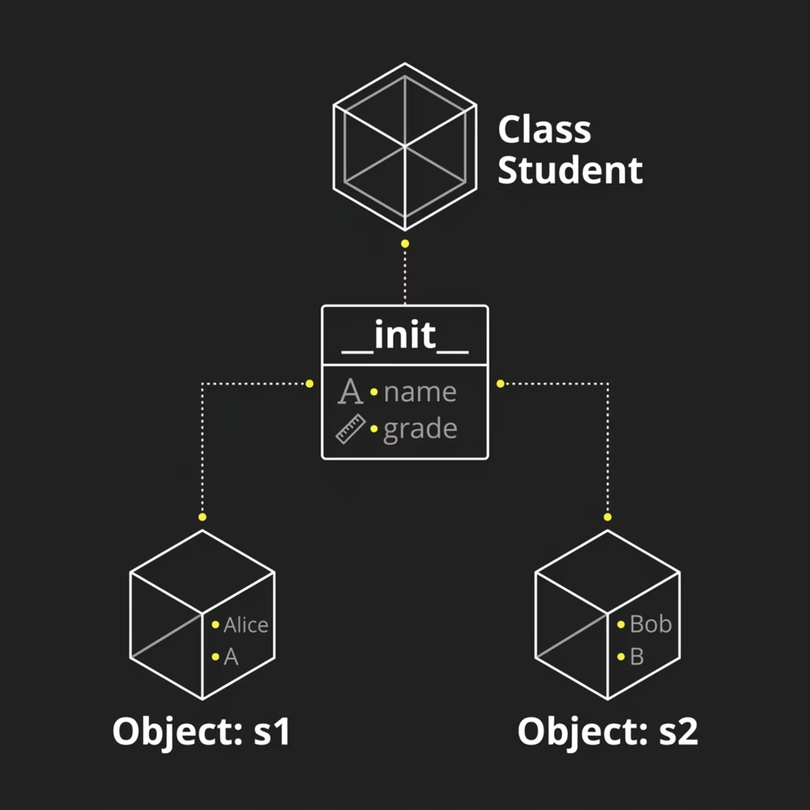


Classes, Objects & the __init__ Constructor
Think of a Class as a Blueprint 🏗️
A class is the blueprint. An object is the actual building built from it. Every object gets its own data.
class Student:
def __init__(self, name, grade):
self.name = name # instance variable
self.grade = grade # instance variable
def greet(self): # method
print(f"Hi, I'm {self.name}!")
# Creating objects
s1 = Student("Alice", "A")
s2 = Student("Bob", "B")
s1.greet() # Output: Hi, I'm Alice!
s2.greet() # Output: Hi, I'm Bob!
🔑 self refers to the specific object calling the method. It tells Python: "use this object's data, not another one's."

Slide 12
Instance Variables & Methods
Explore how objects store their unique data and perform specific actions.
What Makes an Object Unique?
Attributes and Actions in Practice
Instance Variables
Instance variables are variables that belong to an object.
They store:
Object-specific data
Unique information for each object
Each object has its own copy of instance variables.
class Dog:
# Instance variables, unique to each dog
def __init__(self, name, breed):
self.name = name # Each dog has a name
self.breed = breed # Each dog has a breed
self.is_hungry = True # Each dog has a hunger state
# Methods, actions each dog can perform
def bark(self):
return f"{self.name} says Woof!"
def eat(self):
if self.is_hungry:
self.is_hungry = False
return f"{self.name} is now full!"
else:
return f"{self.name} is not hungry."
# Creating unique Dog objects
buddy = Dog("Buddy", "Golden Retriever")
lucy = Dog("Lucy", "Beagle")
# Accessing instance variables (data)
print(f"{buddy.name} is a {buddy.breed}.")
# Calling methods (actions)
print(buddy.bark())
print(lucy.eat())
print(lucy.eat()) # Try again, state has changed!
Data or properties unique to each object. Defined within __init__ using self.variable_name. They hold the state of an object (e.g., a car's color, a student's grade).
Methods
Functions defined within a class that describe the behaviors or actions an object can perform (e.g., a car accelerating, a dog barking). They often interact with the object's instance variables.
self in Action
Ensures that instance variables and methods operate on the specific object you're currently working with. Without it, the method wouldn't know which object's name or is_hungry to reference.

Slide 13
Understanding the self Keyword
The self keyword is fundamental in Python's OOP, linking methods and attributes to specific object instances.
References the Instance
class Robot:
def __init__(self, name, purpose):
self.name = name # Instance variable
self.purpose = purpose
def say_hello(self): # Instance method
return f"Greetings! I am {self.name}, and my purpose is {self.purpose}."
def reprogram(self, new_purpose):
self.purpose = new_purpose
return f"{self.name} has been reprogrammed for {self.purpose}."
# Creating robot objects
robot1 = Robot("Unit 734", "data analysis")
robot2 = Robot("PX-01", "customer support")
# self implicitly passed to say_hello
print(robot1.say_hello())
print(robot2.say_hello())
# Reprogramming a specific robot
robot1.reprogram("advanced diagnostics")
print(robot1.say_hello())
self is a conventional name (though not a keyword) for the first parameter in instance methods, referring to the object itself. It makes sure you're operating on that specific instance's data.
Why It's Required
Python doesn't implicitly know which instance you're talking about. self explicitly tells a method, "use the attributes and methods of this current object."
Memory & Object Identity
Each object occupies its own space in memory. self acts as a pointer to this unique memory location, ensuring methods can access and modify its unique variables without affecting other instances.
Common Confusion
Beginners often forget self or misunderstand its role. Remember: it's not passed explicitly when calling a method (Python does that), but it must be defined as the first parameter in the method signature.

Slide 14

Inheritance, Overriding & Encapsulation
OOP's most powerful features — write less code and protect your data.
Inheritance
Method Overriding
A child class inherits all attributes and methods from a parent class. Add or override only what's different.
Redefine a parent method in the child class. The child's version takes priority — this is polymorphism.
class Animal:
def speak(self): print("...")
class Dog(Animal):
def speak(self): print("Woof!")
d = Dog()
d.speak() # Woof! (not "...")
Encapsulation
Operator Overloading
Hide sensitive data using private (__var) or protected (_var) variables. Access via methods only.
Customize how operators work on your objects using magic methods like __add__ and __str__.
class Bank:
def __init__(self):
self.__balance = 0 # private
def __add__(self, other):
return self.val + other.val
📌 Data Science Note: Libraries like pandas and NumPy use OOP heavily — understanding classes helps you use them like a pro.

Slide 15
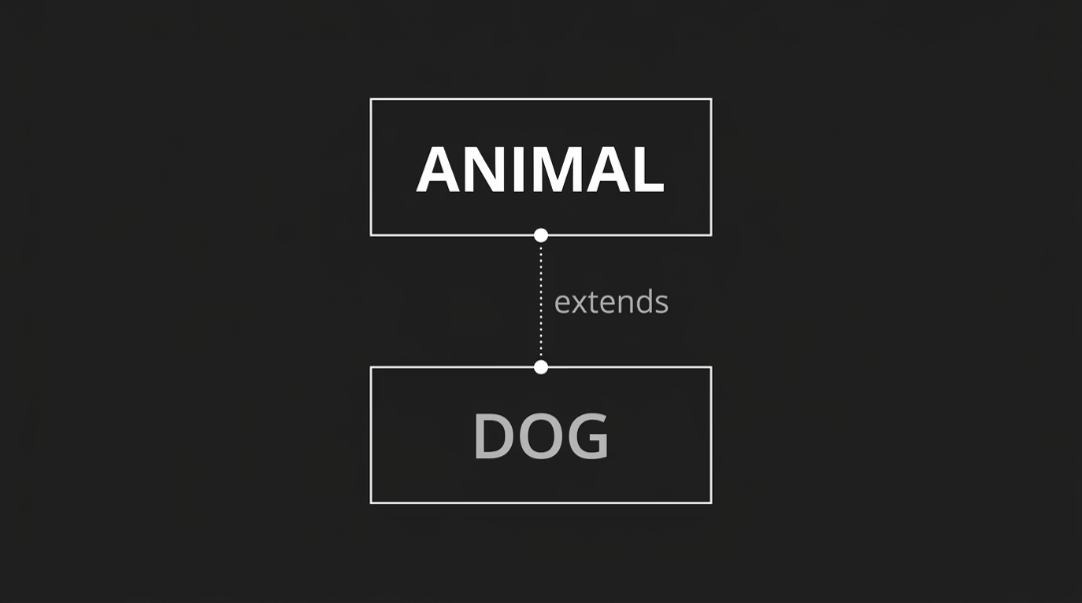

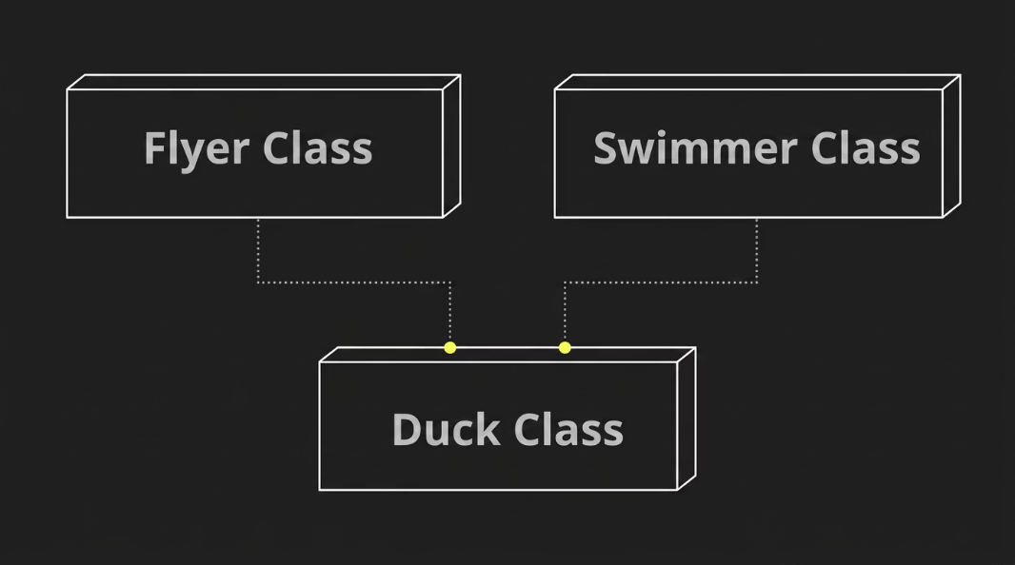


Inheritance: Building on Foundations
Inheritance is a cornerstone of OOP, allowing new classes to build upon existing ones, promoting code reuse and establishing clear relationships.
Single Inheritance
Multiple Inheritance
A child class (subclass) inherits attributes and methods from a single parent class (superclass). This creates a direct "is-a" relationship, e.g., a "Dog is an Animal".
A child class inherits from multiple parent classes, combining their functionalities. This can be powerful but also complex (e.g., the "diamond problem" in some languages).
class Animal:
def __init__(self, name):
self.name = name
def speak(self):
return "Generic animal sound"
class Dog(Animal): # Dog inherits from Animal
def __init__(self, name, breed):
super().__init__(name) # Call parent's constructor
self.breed = breed
def speak(self): # Overrides parent's speak
return f"{self.name} barks!"
my_dog = Dog("Buddy", "Golden")
print(my_dog.speak()) # Output: Buddy barks!
class Flyer:
def fly(self):
return "I can fly!"
class Swimmer:
def swim(self):
return "I can swim!"
class Duck(Flyer, Swimmer): # Duck inherits from Flyer AND Swimmer
def quack(self):
return "Quack!"
my_duck = Duck()
print(my_duck.fly()) # Output: I can fly!
print(my_duck.swim()) # Output: I can swim!
📌 Code Reuse: Inheritance drastically reduces redundant code. Instead of rewriting common functionalities, child classes simply inherit them from their parents, making your codebase cleaner and more maintainable.

Slide 16

Method Overriding: Customizing Inherited Behavior
Method overriding allows child classes to redefine methods inherited from their parent classes, enabling specialized behavior while maintaining a common interface.
The Power of Overriding
Practical Example: Shape Classes
1
Redefining Inherited Methods
class Shape:
def draw(self):
return "Drawing a generic shape."
class Circle(Shape):
def draw(self): # Overrides Shape's draw()
return "Drawing a circle."
class Rectangle(Shape):
def draw(self): # Overrides Shape's draw()
return "Drawing a rectangle."
# Demonstrating polymorphism
shapes = [Shape(), Circle(), Rectangle()]
for s in shapes:
print(s.draw())
# Output:
# Drawing a generic shape.
# Drawing a circle.
# Drawing a rectangle.
A child class (subclass) can provide its own specific implementation of a method that is already defined in its parent class (superclass). This allows objects of the child class to exhibit unique behaviors.
2
Enabling Polymorphism
Method overriding is fundamental to polymorphism. It means objects of different classes can be treated as objects of a common superclass, but when an overridden method is called, the specific version of the child class is executed.
📌 Key Takeaway: Overriding promotes code maintainability by allowing you to define a general contract in the parent class and implement specific details in child classes, without changing the way you interact with the objects.

Slide 17

Operator Overloading: Customizing Python's Behavior
Go beyond standard operations. Operator overloading allows your custom objects to respond to built-in Python operators (like +, -, *) and functions (like print(), len()) in intuitive ways. This makes your classes feel like native types and significantly improves code readability.
1
What are "Special Methods"?
Example: Custom Vector Addition
Also known as "magic methods" or "dunder methods" (for "double underscore"), these are predefined methods in Python (e.g., __add__, __str__, __len__) that allow you to define how your objects interact with language constructs.
Let's make a Vector class that supports addition and string representation.
class Vector:
def __init__(self, x, y):
self.x = x
self.y = y
# Overload the '+' operator
def __add__(self, other):
if isinstance(other, Vector):
return Vector(self.x + other.x, self.y + other.y)
raise TypeError("Can only add Vector to another Vector")
# Overload the str() and print() function
def __str__(self):
return f"Vector({self.x}, {self.y})"
# Step-by-step demonstration
v1 = Vector(2, 3)
v2 = Vector(4, 1)
print(f"Vector 1: {v1}") # Uses __str__
print(f"Vector 2: {v2}") # Uses __str__
v3 = v1 + v2 # Uses __add__
print(f"Sum (v1 + v2): {v3}")
# Output:
# Vector 1: Vector(2, 3)
# Vector 2: Vector(4, 1)
# Sum (v1 + v2): Vector(6, 4)
2
Customizing Operator Behavior
By implementing these special methods in your classes, you can control how standard operators and built-in functions behave when applied to instances of your class. For example, __add__ defines the behavior of the + operator.
3
Enhancing Readability & Intuition
Instead of calling specific methods like vector1.add(vector2), you can write more natural, mathematical expressions like vector1 + vector2. This makes your code more Pythonic and easier to understand.
📌 Data Science Note: Libraries like NumPy extensively use operator overloading for array operations. Understanding this concept helps you appreciate how expressions like arr1 + arr2 or np.mean(data) work under the hood with custom data types.

Slide 18

Encapsulation & Abstraction: Mastering Complexity
Encapsulation and Abstraction are two fundamental pillars of Object-Oriented Programming (OOP) that help manage complexity by structuring code, protecting data, and providing clear interfaces for interaction.
Encapsulation: Data Hiding & Bundling
Abstraction: Focusing on What, Not How
Encapsulation is the mechanism of restricting direct access to an object's internal data and requiring interaction through well-defined public methods. This prevents accidental modification of data and ensures the object's integrity.
Abstraction means showing only essential information and hiding complex implementation details from the user. It allows you to focus on whathow
Think of a car:
In Python, encapsulation is achieved through conventions:
What: You use the steering wheel, pedals, and gear shift.
How: You don't need to know the intricate workings of the engine, transmission, or fuel injection system.
Public: `variable_name` (default, accessible from anywhere)
Protected: `_variable_name` (single underscore, convention for internal use, but still accessible)
Private: `__variable_name` (double underscore, name mangling makes it harder to access directly)
In Python, abstraction can be achieved using abstract base classes (ABCs) from the abc module, defining methods that must be implemented by concrete subclasses.
from abc import ABC, abstractmethod
class PaymentProcessor(ABC): # Abstract Base Class
@abstractmethod
def process_payment(self, amount):
pass # Must be implemented by subclasses
class CreditCardProcessor(PaymentProcessor):
def process_payment(self, amount):
print(f"Processing credit card payment of ${amount}.")
# ... complex credit card logic here ...
return True
class PayPalProcessor(PaymentProcessor):
def process_payment(self, amount):
print(f"Processing PayPal payment of ${amount}.")
# ... complex PayPal API integration here ...
return True
# user_processor = PaymentProcessor() # Cannot instantiate ABC directly
cc_processor = CreditCardProcessor()
cc_processor.process_payment(150)
pp_processor = PayPalProcessor()
pp_processor.process_payment(75)
class BankAccount:
def __init__(self, balance):
self.__balance = balance # Private attribute
def deposit(self, amount):
if amount > 0:
self.__balance += amount
print(f"Deposited {amount}. New balance: {self.__balance}")
else:
print("Deposit amount must be positive.")
def get_balance(self): # Public method to access balance
return self.__balance
account = BankAccount(100)
account.deposit(50)
# print(account.__balance) # This would raise an AttributeError!
print(account.get_balance()) # Access via public method
📌 Synergy: Encapsulation protects the data within an object, while Abstraction provides a simplified view of the object to the
outside world, together making complex systems easier to manage and understand.

Slide 19


What Is __name__ == "__main__"?
What ia __name__?
__name__ is a special built-in variable in Python.
Python automatically creates it for every file.
It stores:
The name of the current module/file
__name__ tells Python which file is currently running.
What is __main__?
When a Python file is executed directly:
__name__ = "__main__"
Every Python file has a built-in variable called __name__. When you run a file directly, Python sets __name__ = "__main__". When you import it as a module, __name__ becomes the file's name.
Think of it like a name tag: "Am I the main event, or am I a guest?"
🏠 Running Directly
📦 Imported as Module
__name__ is "__main__" — your code runs.
__name__ is the filename — your code stays quiet.

Slide 20

Seeing __main__ in Action
🖥️ Output (Run Directly)
# File: my_module.py
def greet():
print("Hello from my_module!")
if __name__ == "__main__":
print("Running directly!")
greet()
Running directly!
Hello from my_module!
📥 Output (Imported)
# Nothing prints!
# greet() can still be called
Common Mistake: Forgetting the guard means code runs on import — a frequent source of bugs!

Slide 21
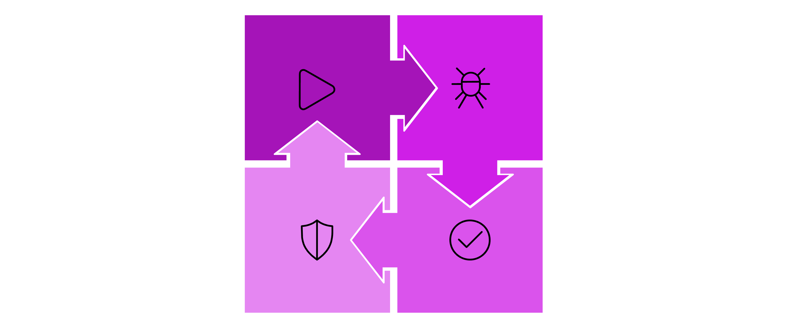
Exception Handling: try / except / else / finally
Try
Except
Finally
Else
Exception handling keeps your program from crashing. Think of it like a safety net — if something goes wrong, Python catches the error and you decide what happens next.

Slide 22
Exception Handling in Code
try:
num = int(input("Enter a number: "))
result = 10 / num
print(f"Result: {result}")
except ValueError:
print("Please enter a valid number!")
except ZeroDivisionError:
print("Can't divide by zero!")
else:
print("

Slide 23


Common Exceptions You'll Encounter
ValueError
TypeError
Right type, wrong value.
Wrong type for an operation.
int("hello")
"age: " + 25
FileNotFoundError
File path doesn't exist.
open("data.csv")
Debugging Tip: Read the last line of the traceback — it tells you the exception type and what went wrong.

Slide 24

Custom Exceptions with raise
Sometimes Python's built-in errors aren't specific enough. You can create your own exceptions to signal custom error conditions — especially useful for data validation.
🔬 Data Science Use Case
Validate dataset columns before analysis:
if df["salary"].min() < 0:
raise ValueError(
"Negative salary found!"
)
class AgeError(Exception):
pass
age = int(input("Enter age: "))
if age < 0:
raise AgeError("Age can't be negative!")
Rule: Use raise to stop execution when data breaks your rules.

Slide 25
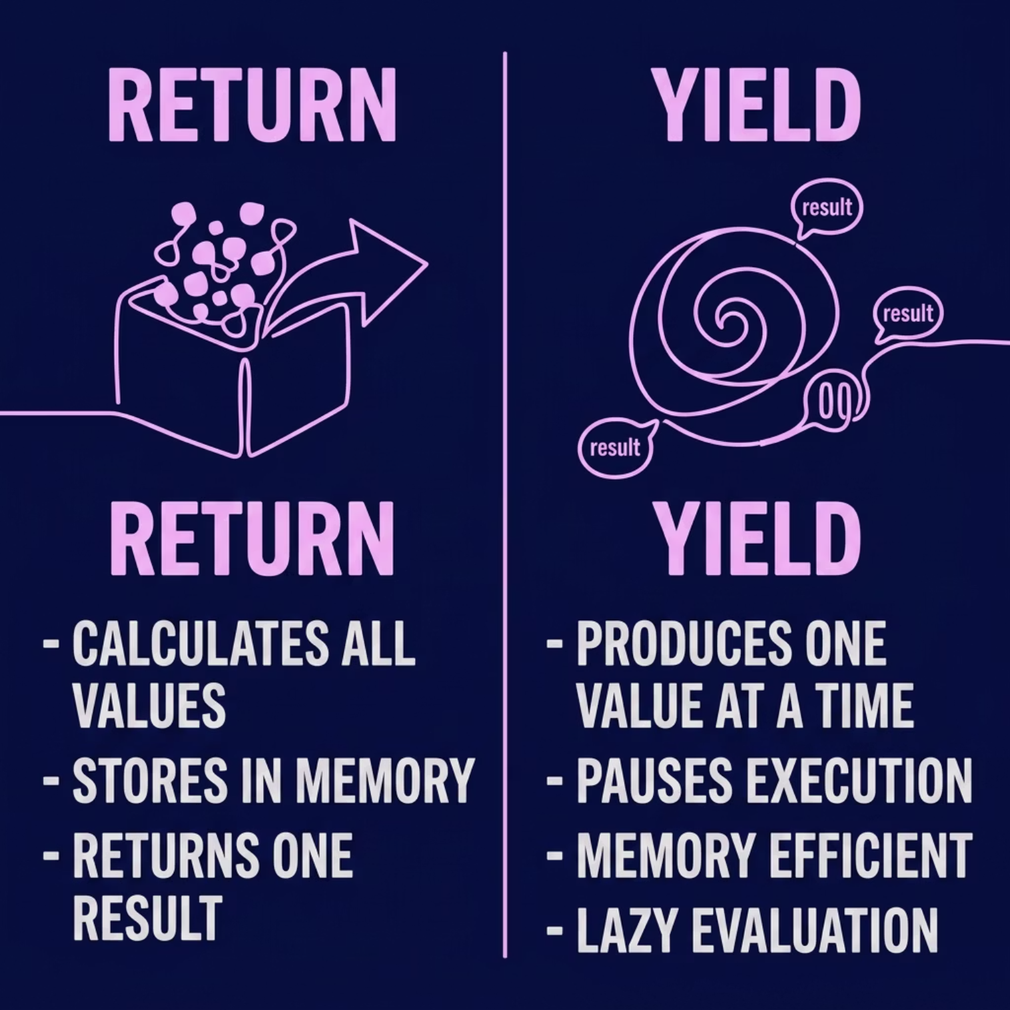

Generators & yield
A generator is a special function that pauses and resumes using yield instead of return. It produces values on demand — perfect for large datasets.
def count_up(n):
i = 1
while i <= n:
yield i
i += 1
for num in count_up(3):
print(num)
Output: 1, 2, 3
Data Science: Use generators to stream large datasets without loading everything into RAM.

Slide 26
Iterators & Decorators
Iterators: iter() & next()
Decorators: @decorator
An iterator remembers where it left off. for loops use iter() and next() behind the scenes.
A decorator wraps a function to add behavior — like logging or authentication — without changing the original code.
it = iter([1, 2, 3])
next(it) # 1
next(it) # 2
@log_calls
def greet(name):
print(f"Hi, {name}!")

Slide 27

Quick Reference Cheat Sheet
__name__ == "__main__"
try / except / finally
Guard so code runs only when executed directly.
Catch errors, handle them, and always clean up.
raise
yield
Trigger custom errors for data validation.
Produce values one at a time — memory efficient.
iter() / next()
@decorator
Manually step through items one by one.
Wrap functions to add logging or auth.
Next Steps: Practice each concept with small programs. Try loading a CSV with try/except and write a generator to stream its rows.

